Slide 1

DEPARTMENT OF ELECTRONICS AND COMMUNICATION ENGINEERING
SRI VASAVI ENGINEERINGCOLLEGE (AUTONOMOUS)
DESIGNING A SMART DEVICE TO ENSURE WOMEN SAFETY
PROJECT GUIDE
Dr.Ch.V. Naga Bhaskar, M.tech., Ph.D
Assistant Professor
PROJECT ASSOCIATES
V. Dharani Kumar (21A81A0466)
M. L. D. Aiswarya (21A81A0438)
M. Kowshika Priya (21A81A0432)
E. Raju (21A81A0416)
G. Bhupendra Prakash (21A81A0417)
HEAD OF THE DEPARTMENT
Dr. E. Kusuma Kumari, M.Tech., Ph.D
Professor & HOD
Batch:13 (ECE-A)

Slide 2
Contents
Abstract
Objective
Introduction
Literature survey
Existing Model
Methodology
Components
Circuit connections
Designed Circuit
Progress
Result
Conclusion
References

Slide 3
Abstract
India faces deep-seated patriarchal issues, including violence related to rape and molestation.
Women's safety is a significant concern due to the constant fear of physical and sexual abuse.
The development of a women's safety device offers a potential solution to these ongoing tragedies.
The smart device features:
Automatic broadcasting of the user's current location via GPS.
Panic button that, when pressed for five seconds, alerts guardians and police.

Slide 4
Objective
Create a smart device with integrated GPS and GSM modules for enhanced women's safety.
Promote quick action in emergencies by sending the user's real-time location to pre-designated emergency contacts.
Press the panic button for five seconds to automatically contact emergency contacts.
Provide women with a discreet, wearable safety solution that enhances their sense of security in daily situations.

Slide 5
Introduction
Women's safety is a significant concern in today’s society, with rising crime rates against women.
It is essential to develop solutions to help prevent incidents of crime against women.
A smart device is a wearable device that integrates sensors, microcontrollers, and communication technology (GSM & GPS) to provide real-time data.
Designed for women's safety, the smart device can detect potential threats and alert family members or authorities in emergency situations.
Our project focuses on utilizing GPS and GSM technologies for tracking and communication with the women's guardians.

Slide 6
Literature Survey
Ref No. | Publication |  | Classification |  |  | Empirical Validation
 | Title | Year | Sensors | Dominating Features | Wearable
[1] | Modern Era and Security of Women: An Intellectual Device | 2020 | Pulse rate sensor | Location tracking | None | Validated
[2] | Voice-Controlled Tool for Anytime Safety of Women | 2021 | Vibration sensor | Location, Shock wave generator | Smart band | Not Validated
[3] | A Raspberry Pi Based Smart Ring for Women Safety Using IoT | 2018 | None | Image capture, Location , tracking | Smart ring | Not Validate
[4] | Design of a Smart Safety Device for Women using IoT | 2019 | Fingerprint sensor | Shock wave, audio recorder, Location tracking | None | Validate

Slide 7
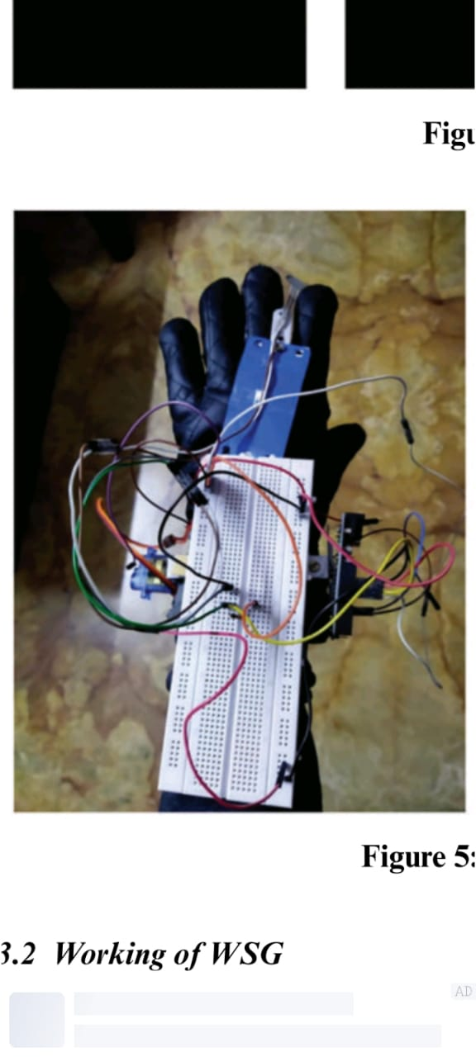
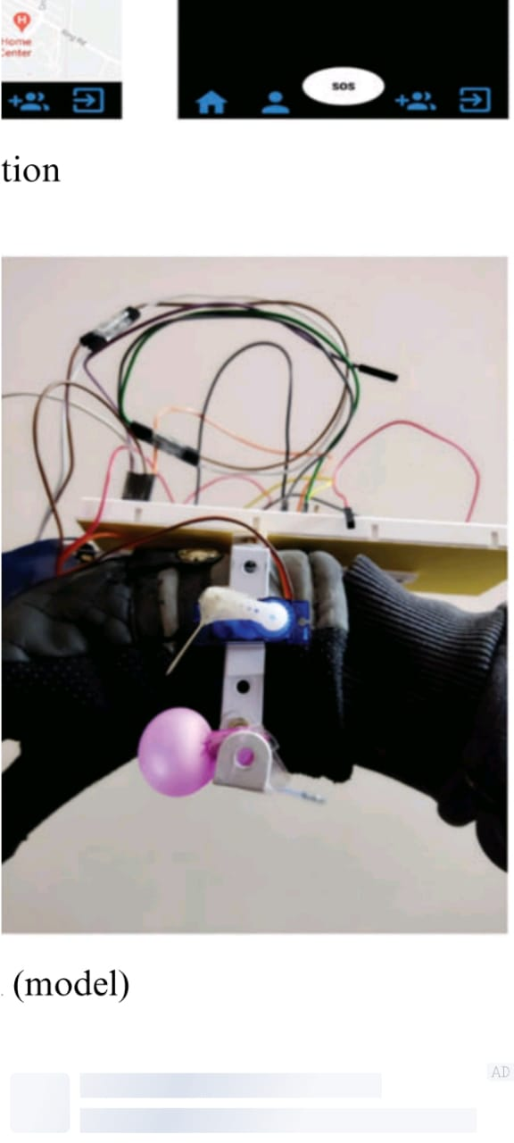
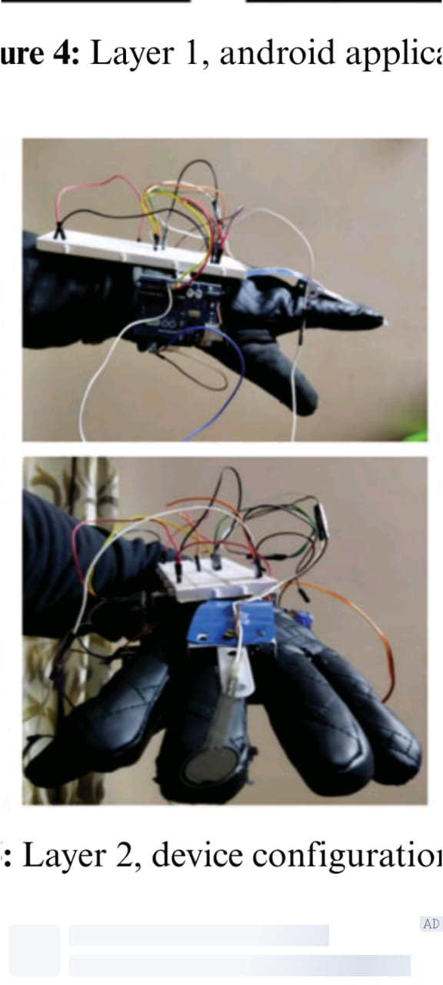
Existing Model
Figs: WOMEN SAFETY GADGET (SMART GLOVE)

Slide 8
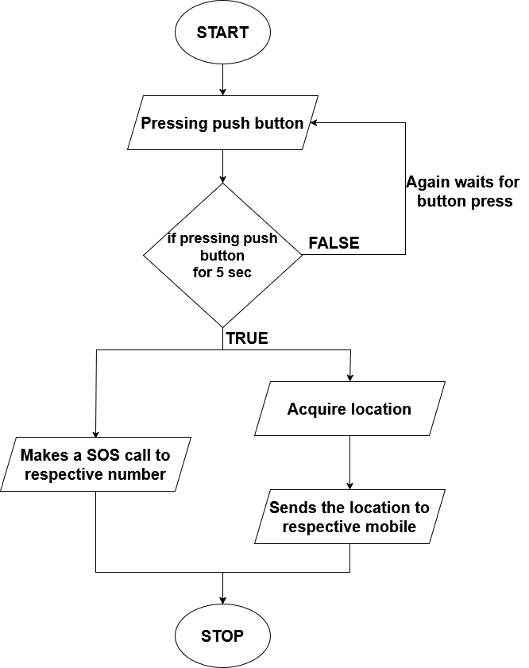
Methodology

Slide 9
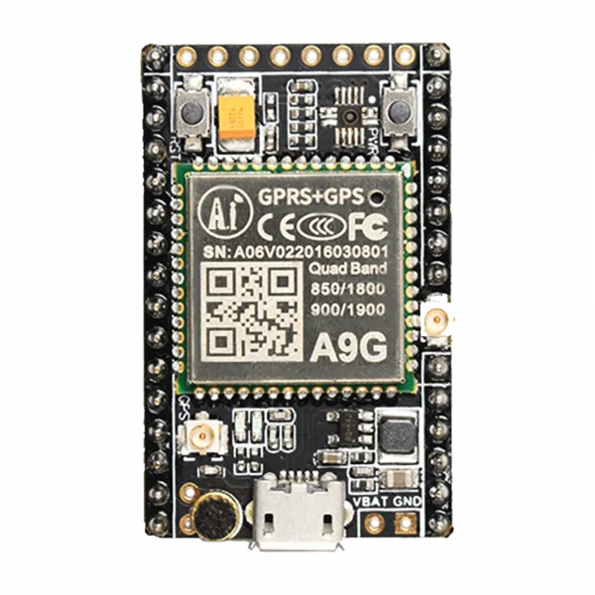
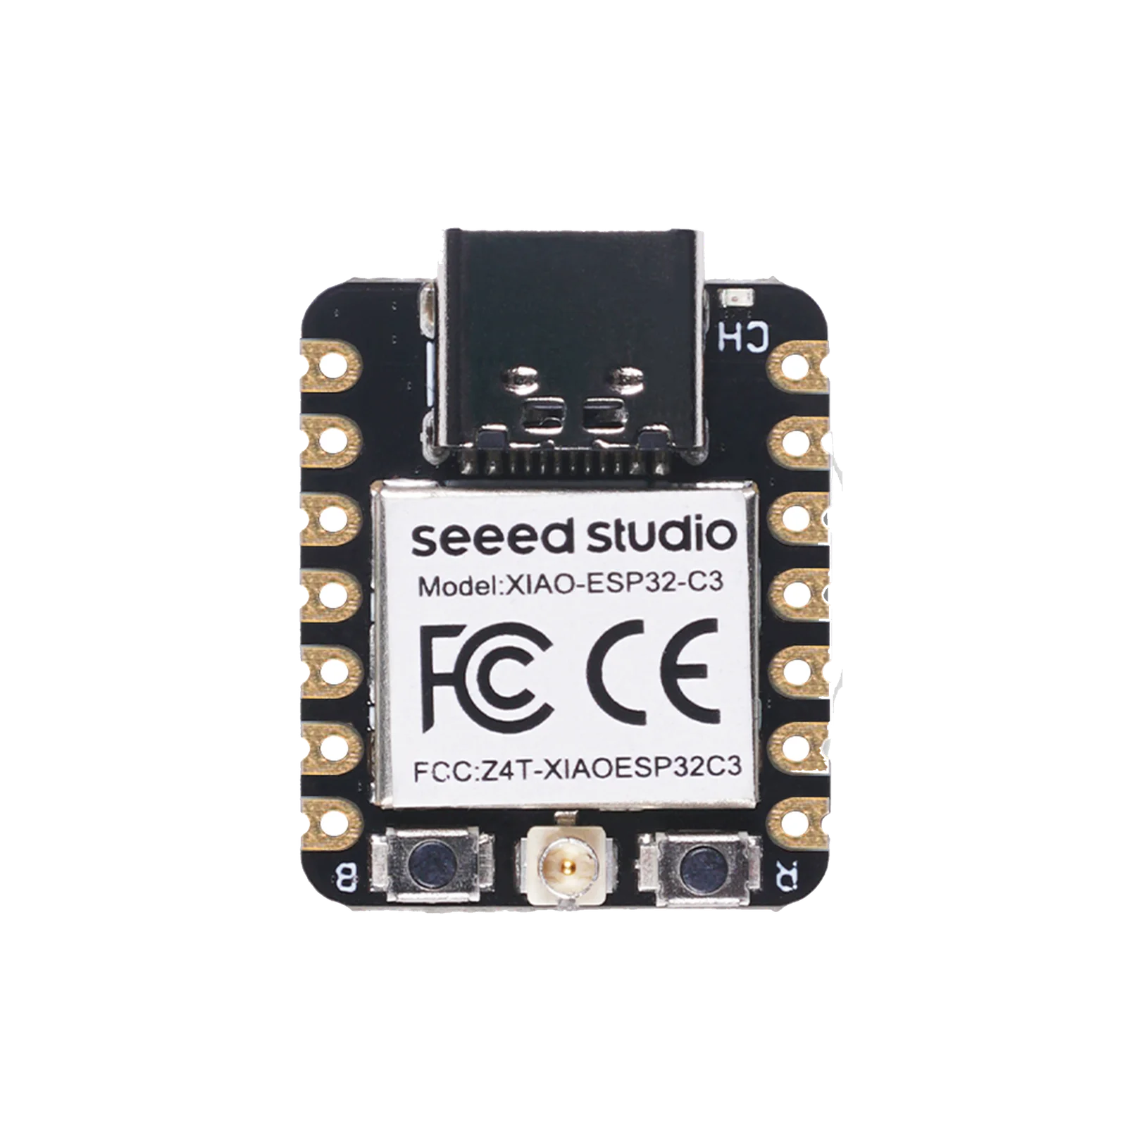
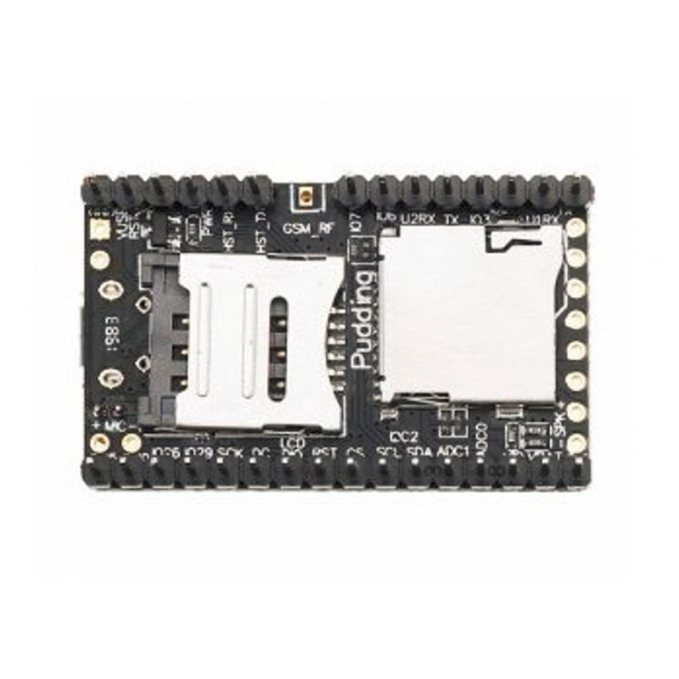
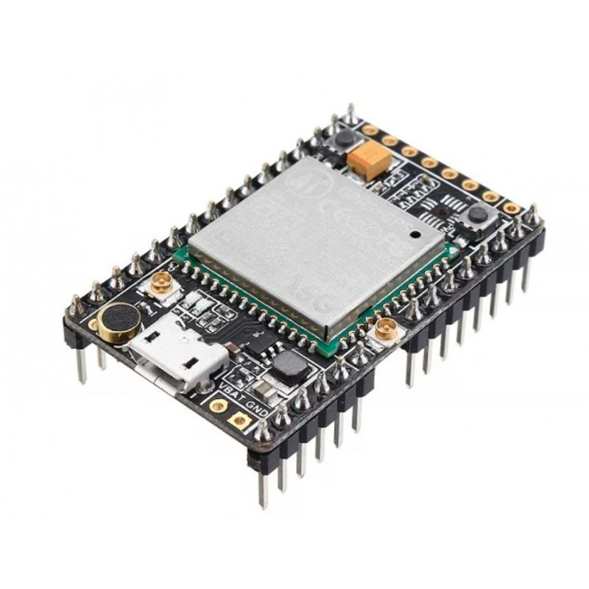
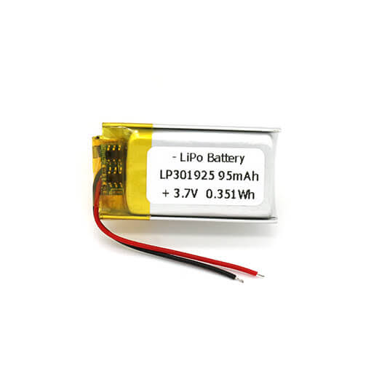
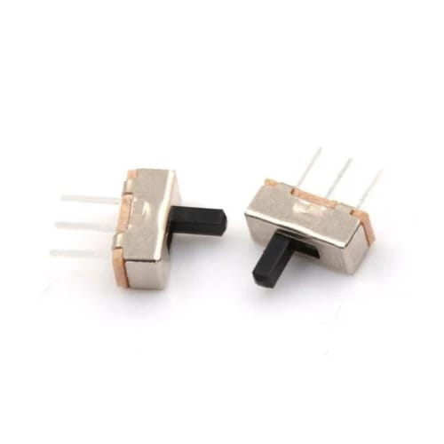
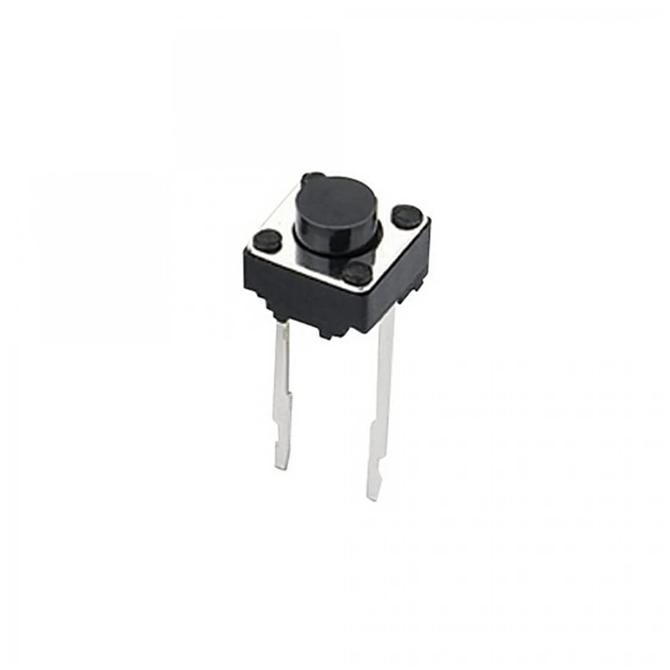
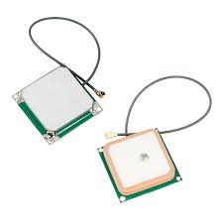
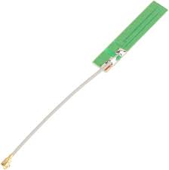
Components
A9G BOARD
A9G BOARD (TOP)
A9G BOARD (BOTTUM)
XIAO C3 BOARD
GPS ANTENNA
GSM ANTENNA
LIPO BATTERY
SLIDE SWITCH
PUSH BUTTON

Slide 10
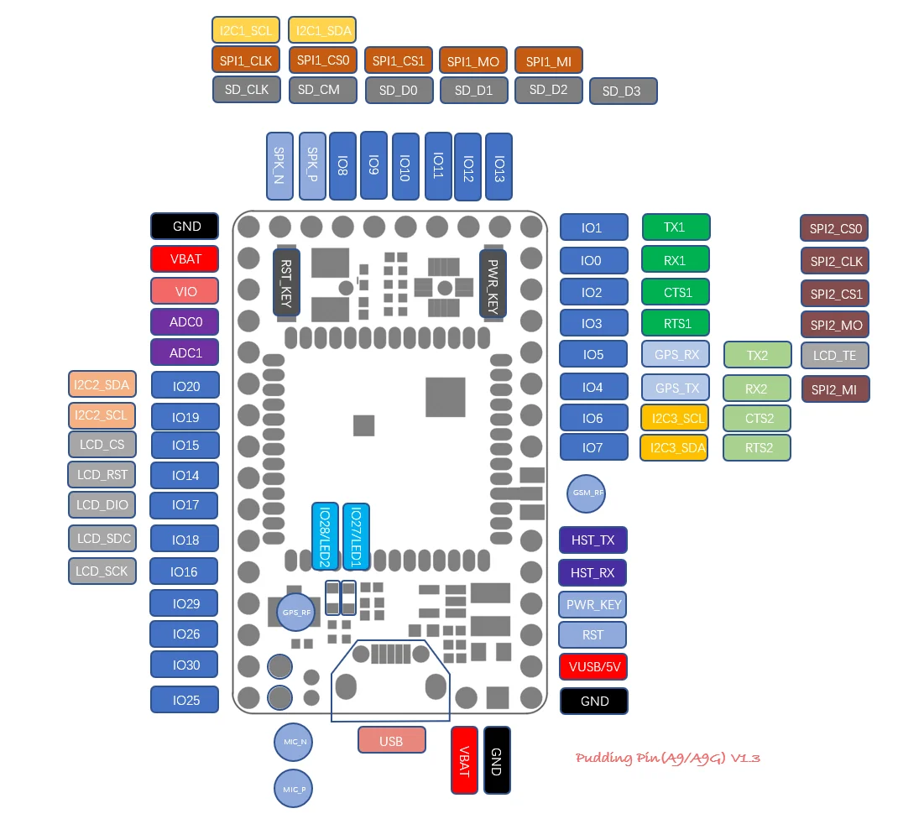
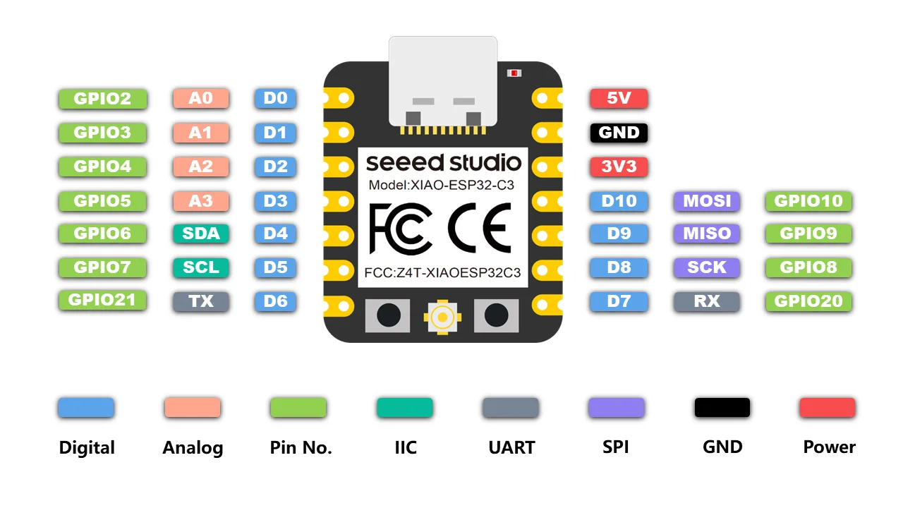
PIN Diagrams
A9G BOARD
XIAO C3 BOARD

Slide 11
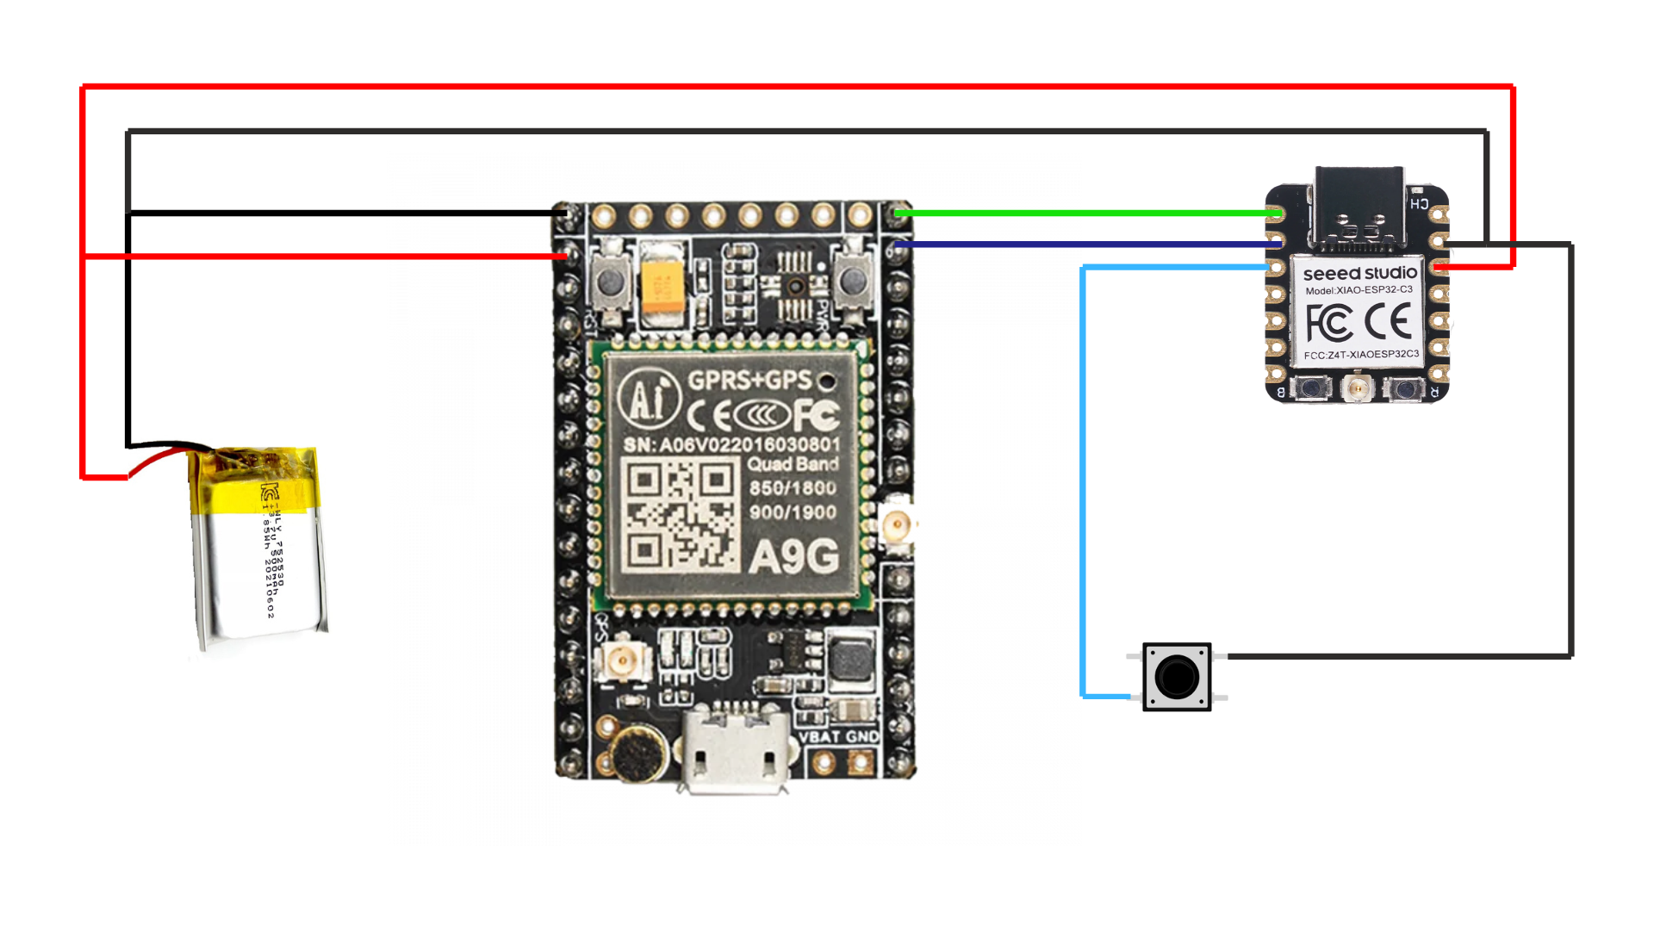
Circuit Connections

Slide 12
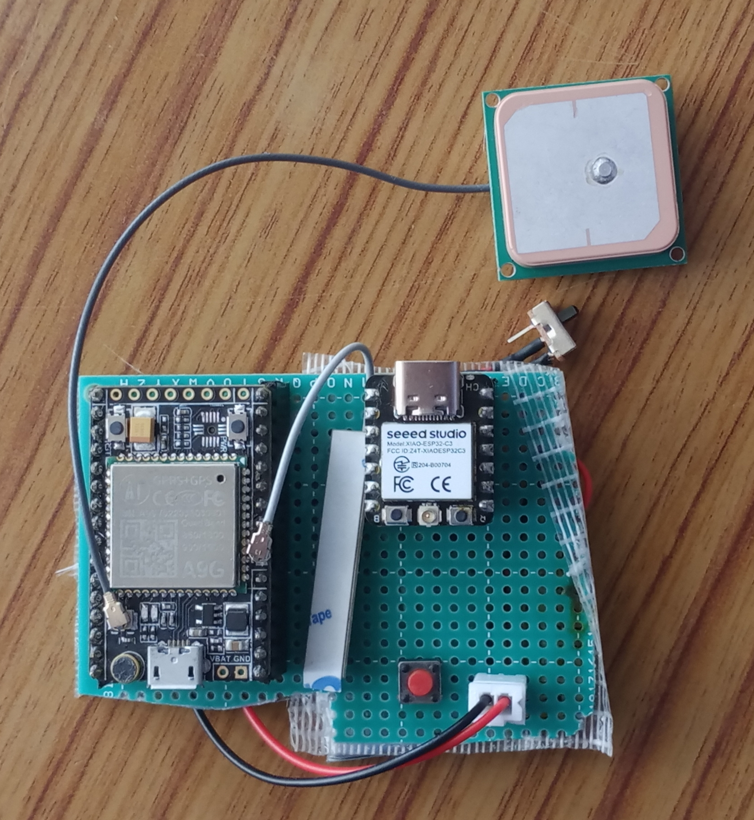
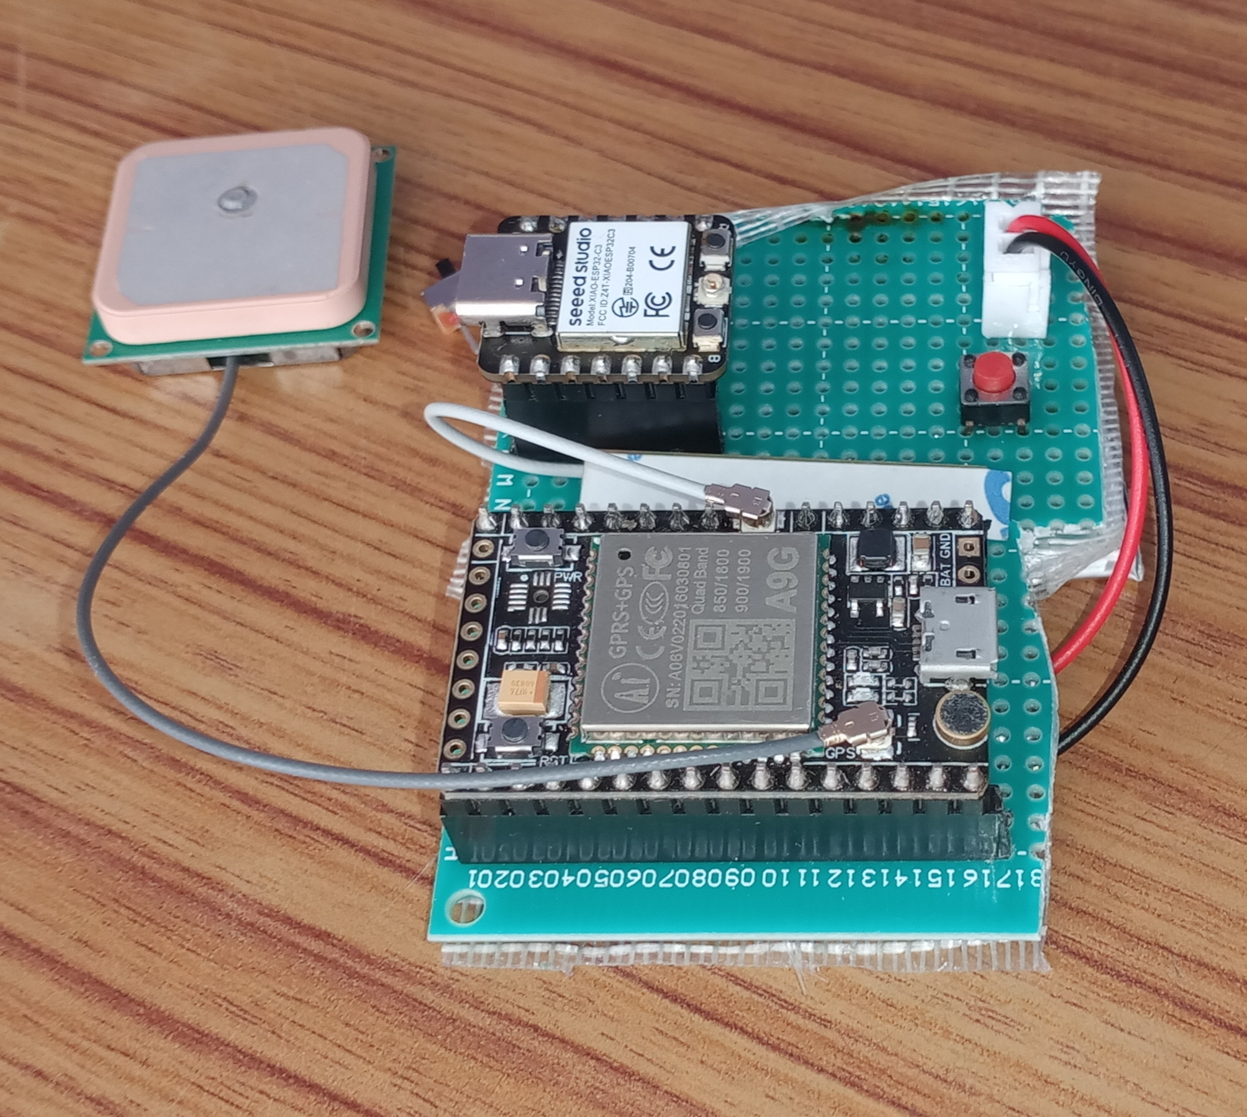
Designed Circuit

Slide 13
Progress
COMPLETED:
Circuit Connections
Code Writing
Sending SOS Alert
Receiving SOS Alert
Initiating SOS Call
Receiving SOS Call
Sending Location via SMS
Receiving Location via SMS

Slide 14

Result

Slide 15


Result

Slide 16
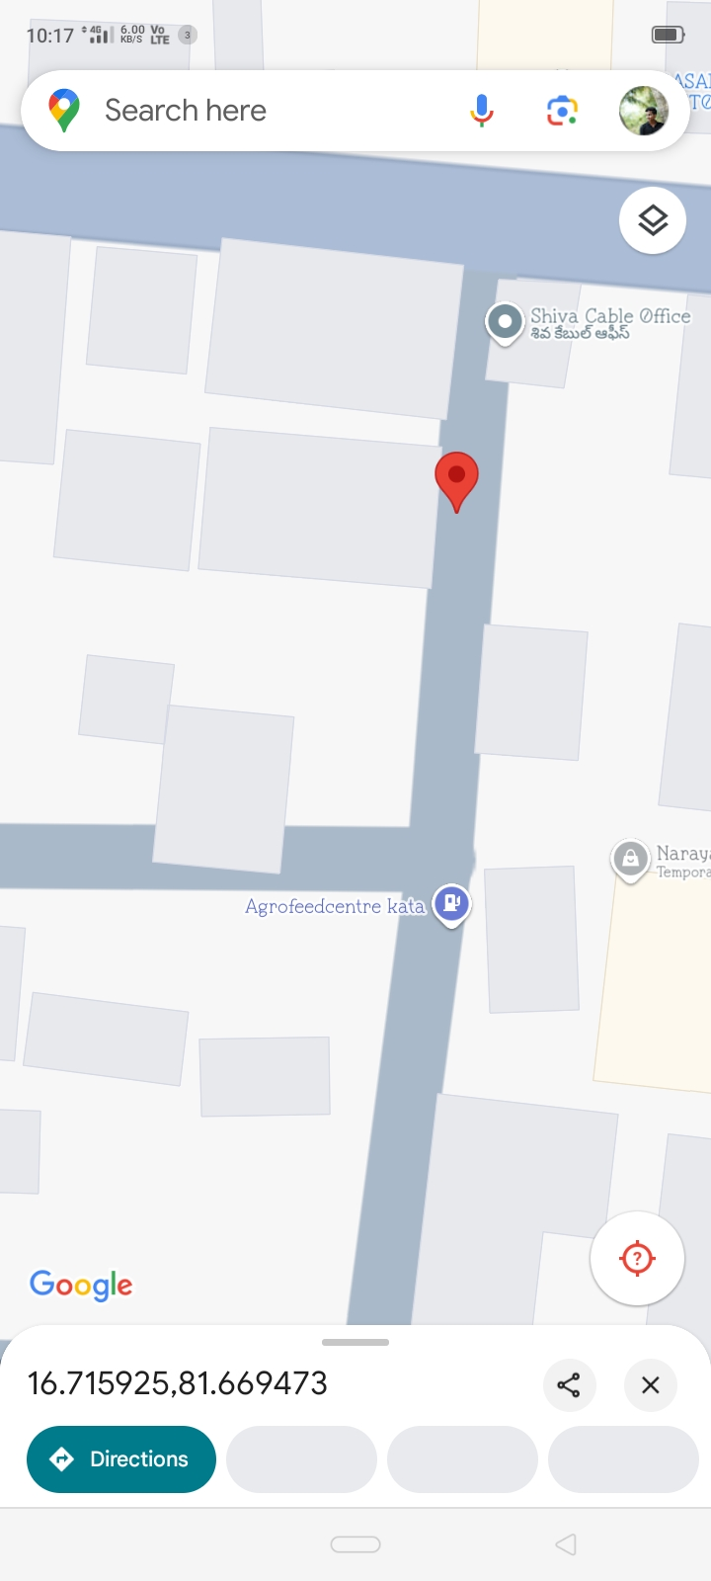
Result

Slide 17
Conclusion
Smart safety devices provide a practical and innovative solution to women's safety concerns.
Integration of GPS and GSM modules ensures real-time location tracking and emergency communication.
Automatic alerts to authorities and guardians enable swift response during critical situations.
The discreet design enhances safety by staying hidden from potential attackers.
These devices empower women with immediate protective measures against threats like abuse and assault.
Widespread adoption could significantly contribute to reducing violence against women.

Slide 18
References
[1] G. Gulati, T. K. Anand, T. S. Anand, and S. Singh, ‘‘Modern era and security of women: An intellectual device,’’ Int. Res. J. Eng. Technol. (IRJET), vol. 7, no. 4, pp. 212–218, 2020.
[2] A. Agrawal, A. Maurya, and A. Patil, ‘‘Voice controlled tool for anytime safety of women,’’ J. Emerg. Technol. Innov. Tool, vol. 8, no. 5, pp. a966–a975, 2021.
[3] N. R. Sogi, P. Chatterjee, U. Nethra, and V. Suma, ‘‘SMARISA: A raspberry Pi based smart ring for women safety using IoT,’’ in Proc. Int. Conf. Inventive Res. Comput. Appl. (ICIRCA), 2018, pp. 451–454.
[4] W. Akram, M. Jain, and C. S. Hemalatha, ‘‘Design of a smart safety device for women using IoT,’’ Proc. Comput. Sci., vol. 165, pp. 656–662, Jan. 2019.

Slide 19
THANK YOU

